Slide 1
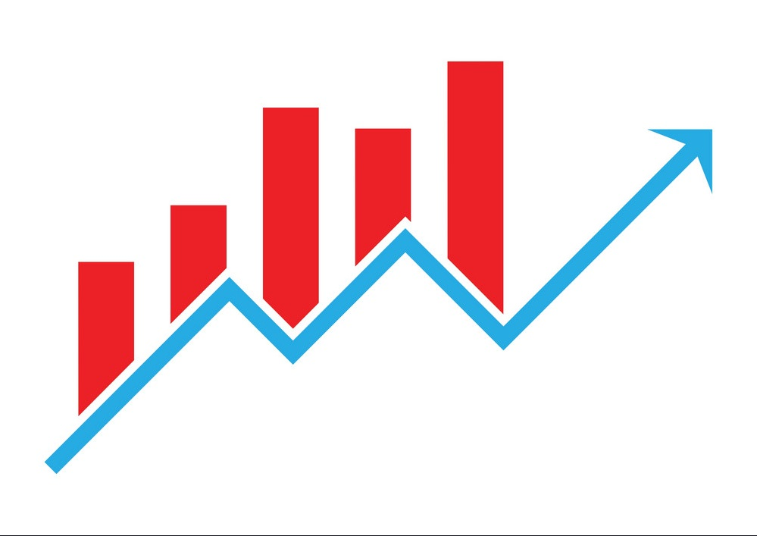
Technical Analysis
By Santosh Singh Lingden

Slide 2
Topics
Introduction to Technical Analysis
Types of Charts and Candlestick Patterns
Support / Resistance and Trend Line
Basic Concepts of Trends and Trend Analysis
Major Reversal Chart Patterns
Major Continuation Chart Patterns
Important Technical Indicators

Slide 3
Types of Analysis
Fundamental Analysis
Technical Analysis

Slide 4
Fundamental Analysis
Intrinsic Value
Eps, PE ratio , Net profit etc
BOP, interest etc
External factors

Slide 5
Technical Analysis is about
Prediction of market on the basis of past price and volume.
Chart patterns and other technical indicators.
It ignores all the factors other than the price

Slide 6
Advantages
Trend direction
Entry and exit
Crowd psychology / sentiment
Flexibility with any market

Slide 7
Disadvantages
Sometimes different signals by different indicators.
Not 100% accurate.
Different opinion of analysts.

Slide 8
Dow Theory Principles
Price discounts everything.
Market has 3 trends. Major, Secondary and Minor.
Major trend of 3 phases. Accumulation, Public participation and Distribution.
The averages must confirm each other.
Volume must confirm the trend.
The trend continues until it gives definite reversal signal.

Slide 9
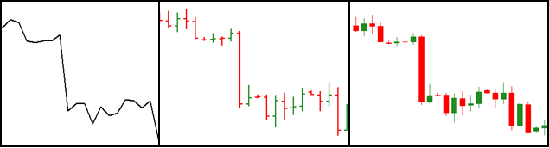
Types of Charts
Most popularly there are three types of charts:
Line Chart
Bar Chart
Candlestick Chart

Slide 10
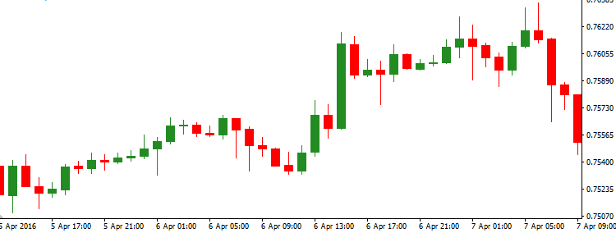
Candlestick Chart
It is widely used in technical analysis
It is similar to bar charts but it has better visual construction
Bullish and bearish candles are differentiated by two different colors

Slide 11
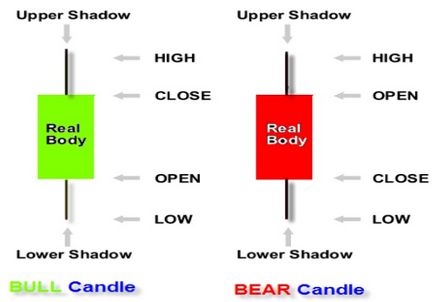
Japanese Candlestick

Slide 12
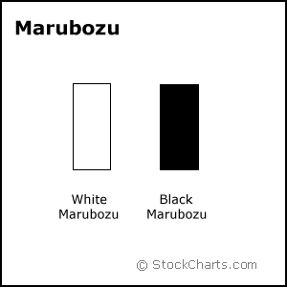
Candlestick Patterns

Slide 13
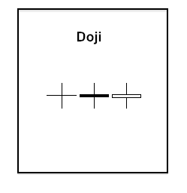
Candlestick Patterns
Doji
Open and Close is same or near to same
Body is very thin, could be a horizontal line
It indicates indecision
It is a warning of a reversal

Slide 14
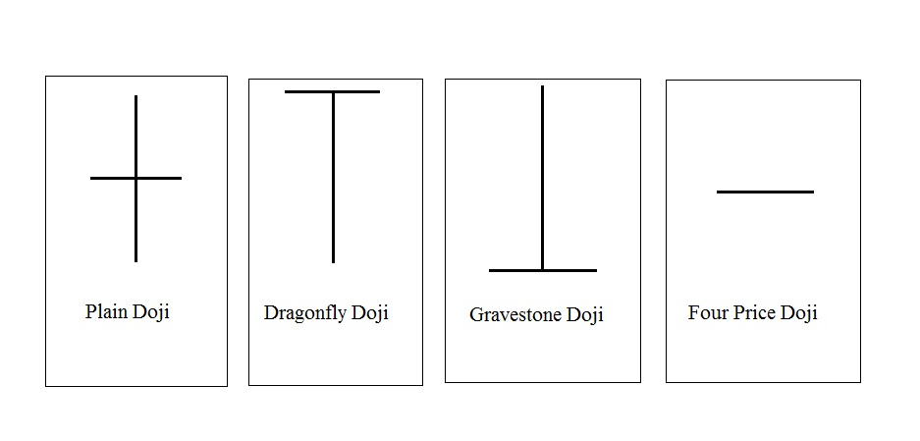
Other types of Doji

Slide 15
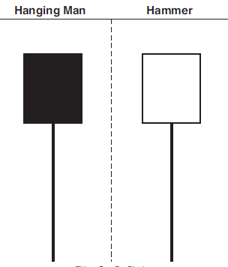
Hanging Man and Hammer
Real body is located at the upper end
Lower shadow is 2-3 times longer
than the real body
Upper shadow is small or nonexistent
Hanging man→in uptrend market→
possible downside move
Hammer→ in a downtrend market→
possible upside move
Colour in both trend does not matter.

Slide 16
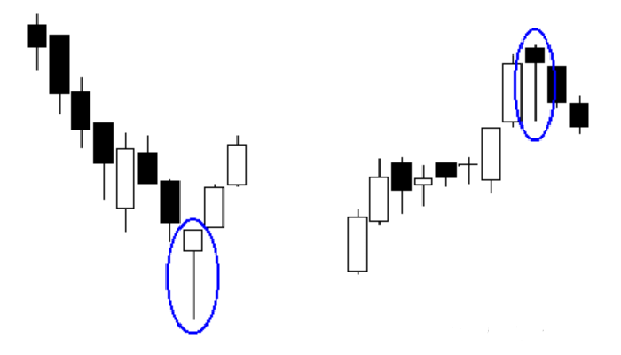
Hammer and Hanging Man

Slide 17
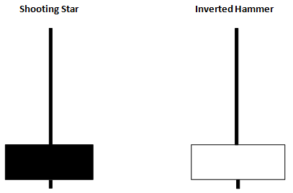

Slide 18
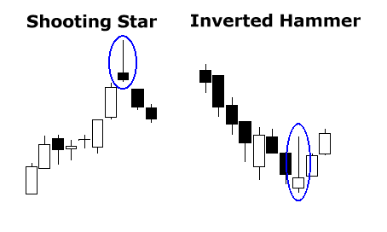
Shooting Star and Inverted Hammer
Real body is located at the lower end
Upper shadow is 2-3 times longer
than the real body
Lower shadow is small or nonexistent
Shooting star →in uptrend market→
possible downside move
Inverted Hammer→
in a downtrend
market→ possible upside move
Reversal candlestick pattern
Can be any colour

Slide 19
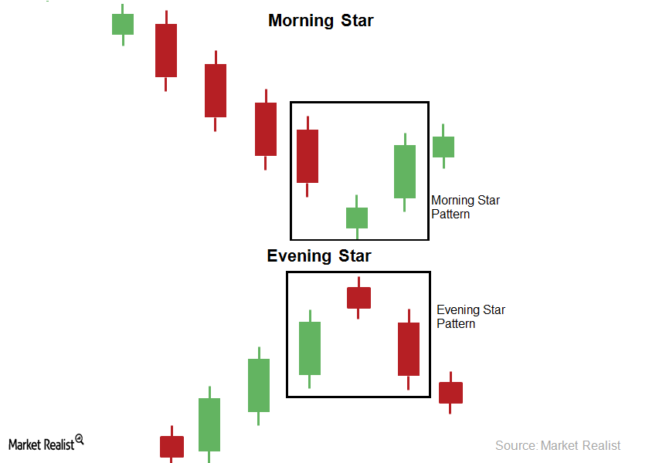
Evening Star and Morning Star
Three bar candlestick pattern
Middle candle is a star
Reversal candlestick pattern

Slide 20
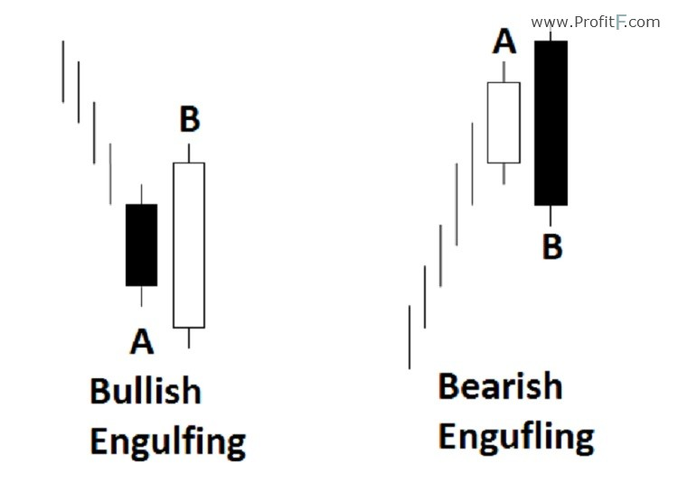
Engulfing
Second body engulfs the first body
It is a reversal candlestick pattern
Bearish engulfing indicates possible downside move
Bullish engulfing indicates possible upside move

Slide 21
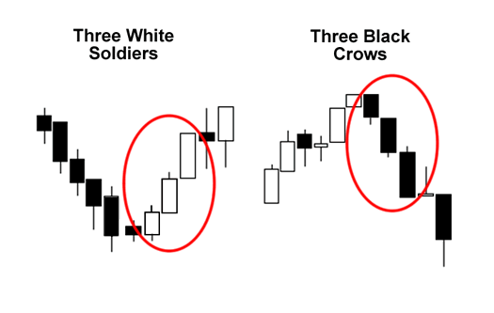
Three Black Crows and Three White Soldiers
Three Black Crows:
3 long bearish candles
Formed after an uptrend
Powerful reversal formation
Three White Soldiers
3 Long bullish candles
Formed after a downtrend
Powerful reversal formation

Slide 22
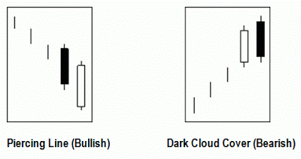
Piercing Line and Dark Cloud Cover

Slide 23
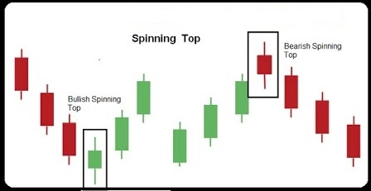
Spinning Tops

Slide 24
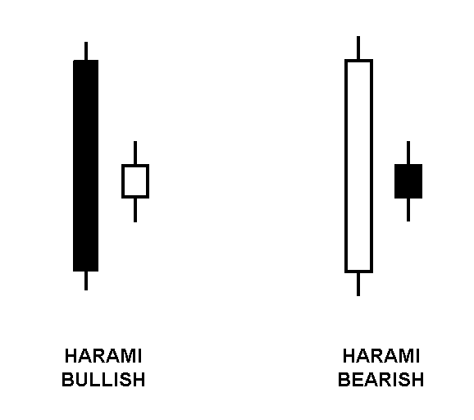
Harami Candles

Slide 25
Candlestick Patterns
Conclusion
Candlestick patterns are short term patterns
Candlestick patterns are often reversal patterns
Many times these patterns can be false
Should not rely simply on these patterns to make trading decisions
Key to making money is riding the trend, such patterns help us determine when a new trend is beginning
Such patterns can also help us determine when a trend is ending
Allows us to enter soon in the trend and exit as quickly as possible

